Slide 1
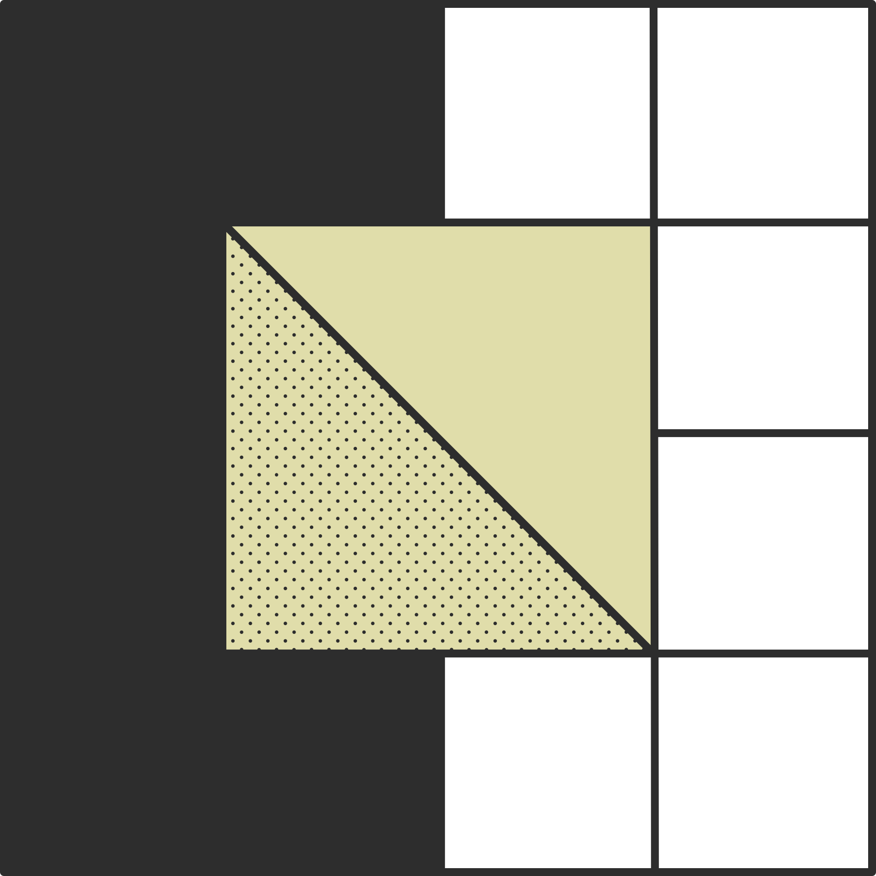

Emulating
HDFS
DSCI 551: Foundations of Data Management
Project Demo
Group Members
Snigdha Chenjeri
Harsh Parikh
Aman Kumar

Slide 2


Design Specifications
NameNode Server: metadata.json
No. of DataNode Servers: 3
Block Size: 2048 bytes (2KB)
Replication Factor: 2
Client-Server Communication: "socket" library
Web Based UI: Flask
2

Slide 3
EDFS Commands
ls <path>
mkdir <path>
rmdir <path>
put <local_src> <edfs_dst>
cat <path>
get <edfs_path> <local_src>
rm <path>
3

